Slide 1
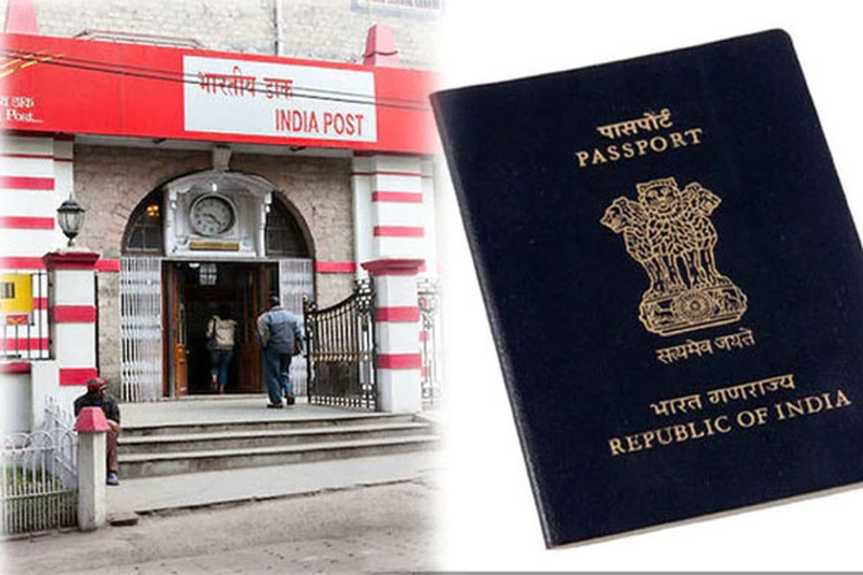
Post Office Passport Seva Kendra (POPSK) - Complete Guide
Everything You Need to Know About Applying for a Passport at POPSK

Slide 2
Introduction to POPSK
- POPSK was introduced to expand passport services to more locations.
- Operates in collaboration with India Post and Passport Seva Kendra.
- Provides passport-related services in remote and semi-urban areas.

Slide 3
Services Offered at POPSK
- Issuance of new passports
- Renewal/Re-issuance of expired passports
- Name or address changes in passports
- Issuance of duplicate passports in case of loss/damage

Slide 4
Difference Between POPSK and PSK
- **POPSK**: Operates within post offices, limited slots, basic verification
- **PSK (Passport Seva Kendra)**: Full-fledged passport office, faster processing, and Tatkal services

Slide 5
How to Apply for a Passport at POPSK
1. Visit the official Passport Seva website: www.passportindia.gov.in
2. Register/Login to your account
3. Fill out the passport application form
4. Choose the nearest POPSK location
5. Pay the required fees online
6. Schedule an appointment

Slide 6
Documents Required
- **For Fresh Passport:**
- Aadhaar Card
- Voter ID
- Birth Certificate (for minors)
- PAN Card (optional)
- Address proof (Electricity bill, Bank Statement, etc.)
- **For Renewal/Re-issuance:**
- Old passport
- Address proof (if changed)
- Affidavits in case of name change, lost passport, etc.

Slide 7
Passport Fees Structure
- **Normal Passport (36 pages)**: ₹1,500
- **Jumbo Passport (60 pages)**: ₹2,000
- **Minor Passport**: ₹1,000
- **Tatkal Services (only at PSK)**: ₹3,500

Slide 8
Appointment & Processing Time
- Book an appointment as per availability
- Visit POPSK on the scheduled date with documents
- Verification by officials
- Police verification (if required)
- Passport processing takes 10-15 working days

Slide 9
Benefits of POPSK
- Easy access for people in small towns and villages
- Reduces congestion at PSKs
- Faster processing for normal applications
- Available in multiple locations across India

Slide 10
Important Tips & FAQs
- Always carry original and photocopies of documents
- Arrive at POPSK 15-30 minutes before appointment time
- Check for document updates on the Passport Seva website
- FAQs on lost passport, delays, and tracking application

Slide 11
Conclusion & Contact Information
- Applying for a passport at POPSK is simple and efficient
- Ensure all documents are accurate to avoid delays
- Visit www.passportindia.gov.in for official updates
- **Subscribe to INFO4EARN for more informative videos!**

